Slide 1
Case 1
58 year old
Right adnexal mass and tiny nodules on the appendix and caecum
Macroscopy: Multicystic ovarian mass measuring 15 cm maximum dimension. Densely packed cystic areas impart a spongy appearance in foci. No solid or papillary component.

Slide 2
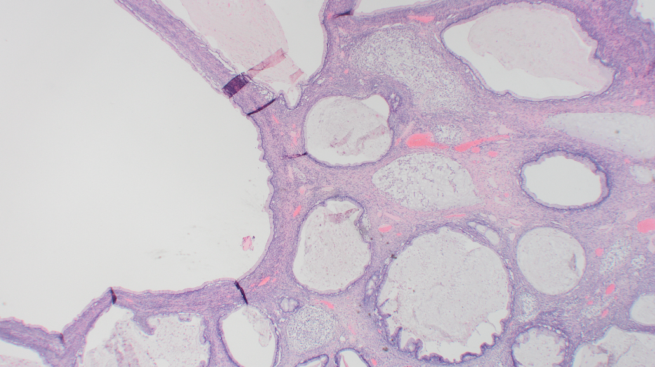

Slide 3
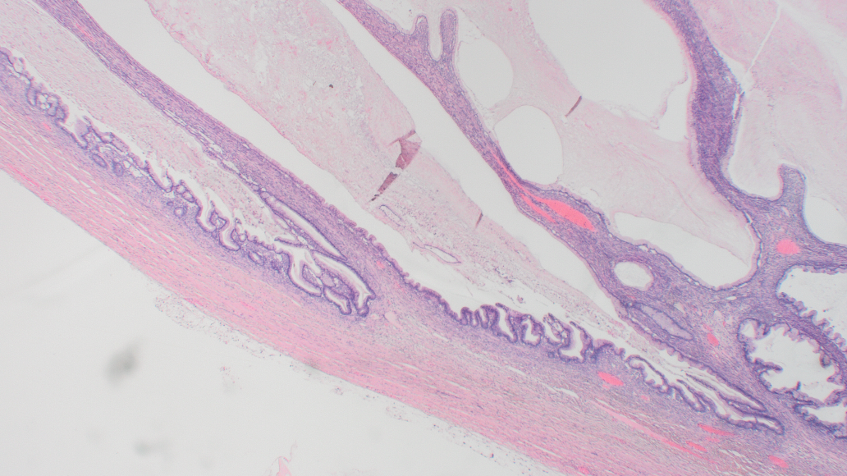

Slide 4
Case 1 Poll questions
Benign mucinous cystadenoma
Borderline mucinous tumour
Primary ovarian mucinous carcinoma - Infiltrative pattern
Metastatic mucinous carcinoma

Slide 5
Case 2
66 year old woman
Unilateral right ovarian mass​
Macroscopy: Multilocular cystic ovary (maximum dimension 12 cm) -ruptured and contains thick yellow mucoid fluid and blood clots. The cyst wall is thickened. No papillary or solid areas identified.

Slide 6
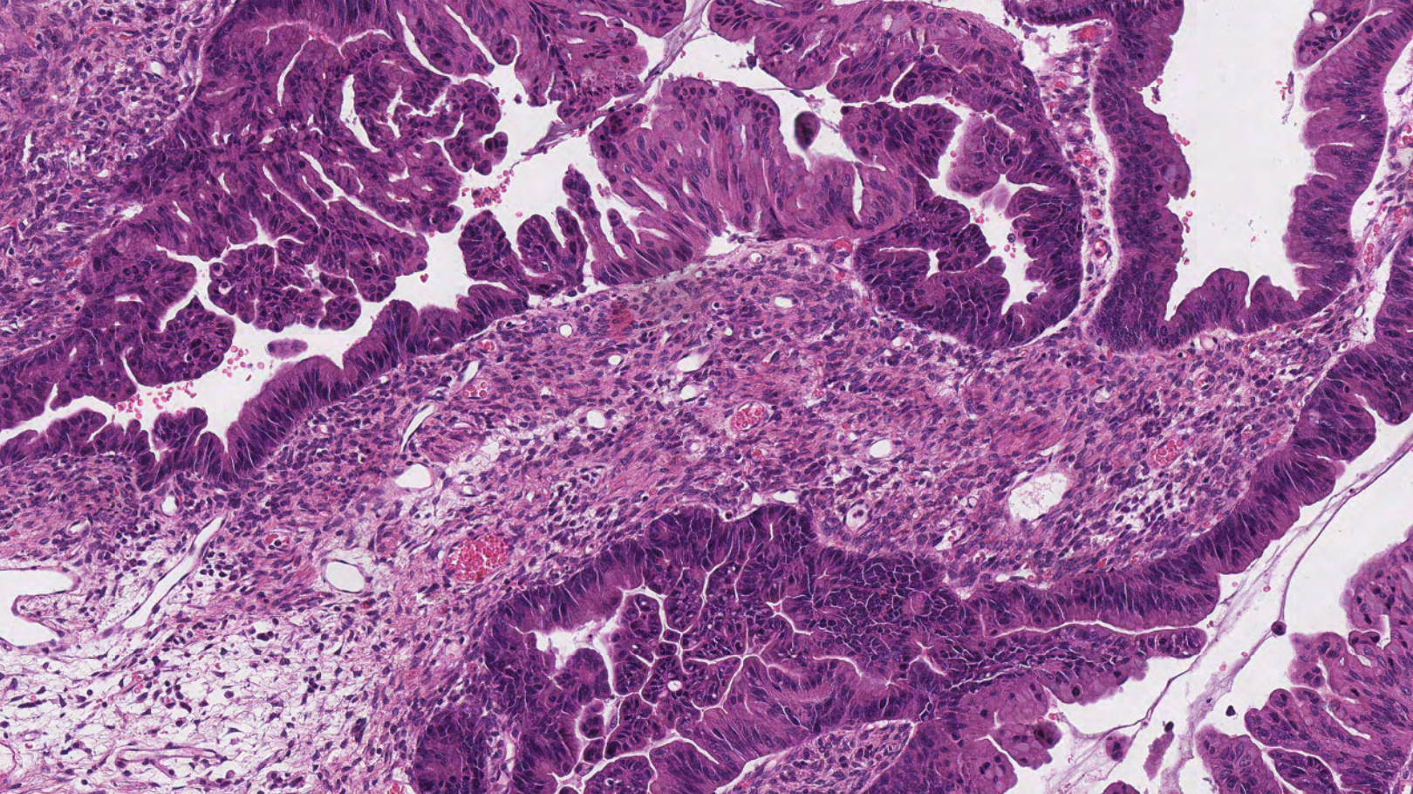

Slide 7
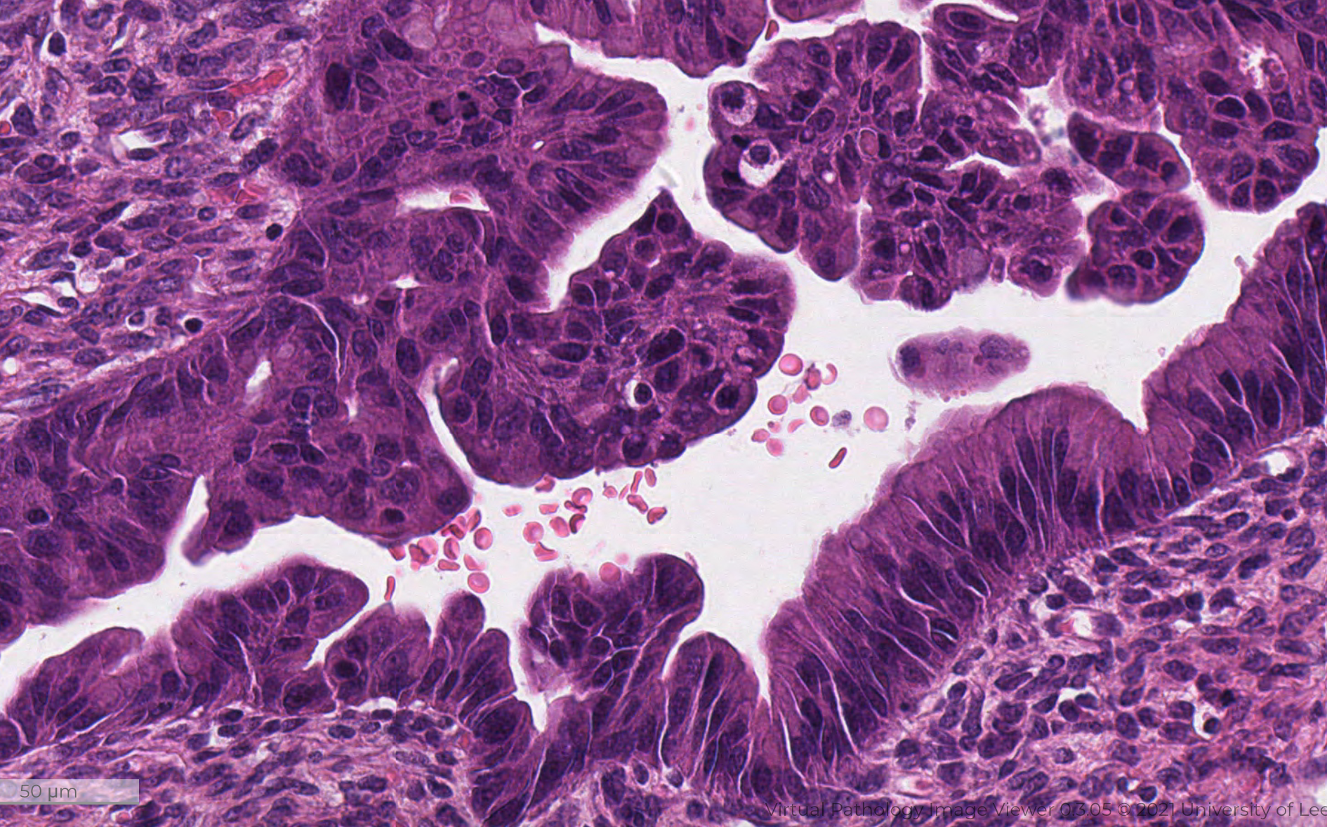

Slide 8
Case 2 Poll questions
Borderline mucinous tumour
Borderline mucinous tumour with intraepithelial carcinoma
Primary ovarian mucinous carcinoma - Infiltrative pattern
Metastatic mucinous carcinoma

Slide 9
Case 3
70 year old woman
TAH BSO for ovarian mass – Left ovarian mass deflated intentionally, no spillage.
Macroscopically 14 cm left ovarian mass, partly adherent to the uterus. Mullticystic with mucinous contents. No solid areas seen. One focus of hemorrhage and necrosis.

Slide 10
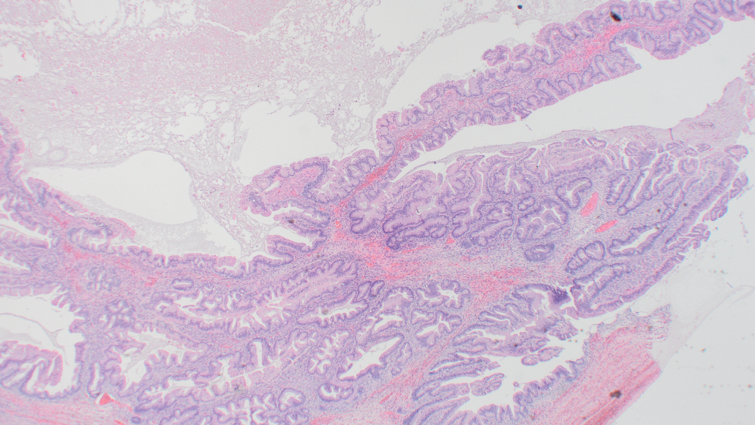

Slide 11
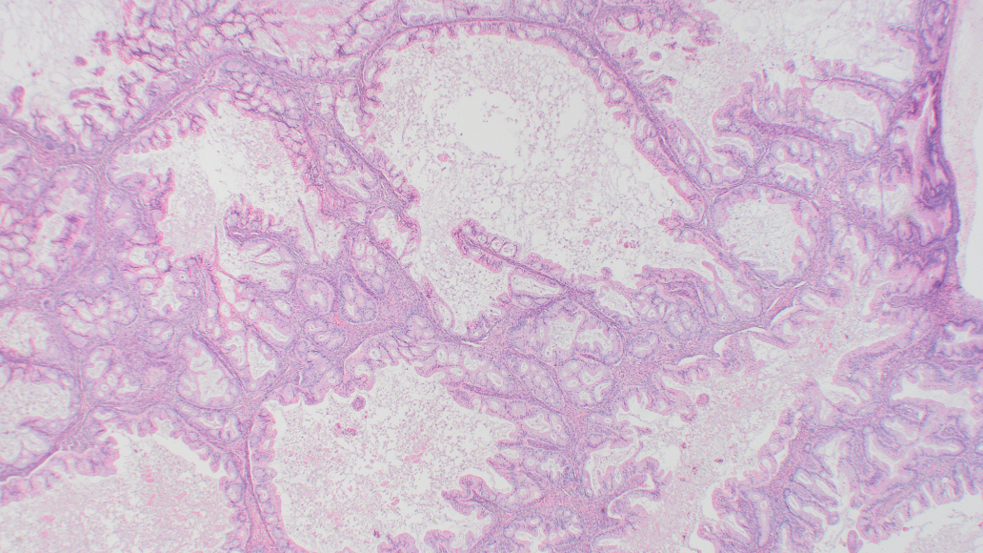

Slide 12
Case 3 Poll questions
Borderline mucinous tumour
Borderline mucinous tumour with intraepithelial carcinoma
Primary ovarian mucinous carcinoma - expansile pattern
Metastatic mucinous carcinoma

Slide 13
Case 4
24 year old woman
Bilateral pelvic masses
Right ovarian cyst​ Multiple pieces of cystic wall with aggregate size of 170 x 100 x 40mm, external surface is smooth and shiny. Maximum wall thickness is 3mm, lining is rough and focally congested.
Left ovarian cyst​ Four pieces of cyst wall with aggregate size of 60 x 55 x 30mm, external surface is smooth and focally congested. Maximum wall thickness is 2mm, the wall is thin and translucent in areas and opaque in other areas. Cyst lining is rough

Slide 14
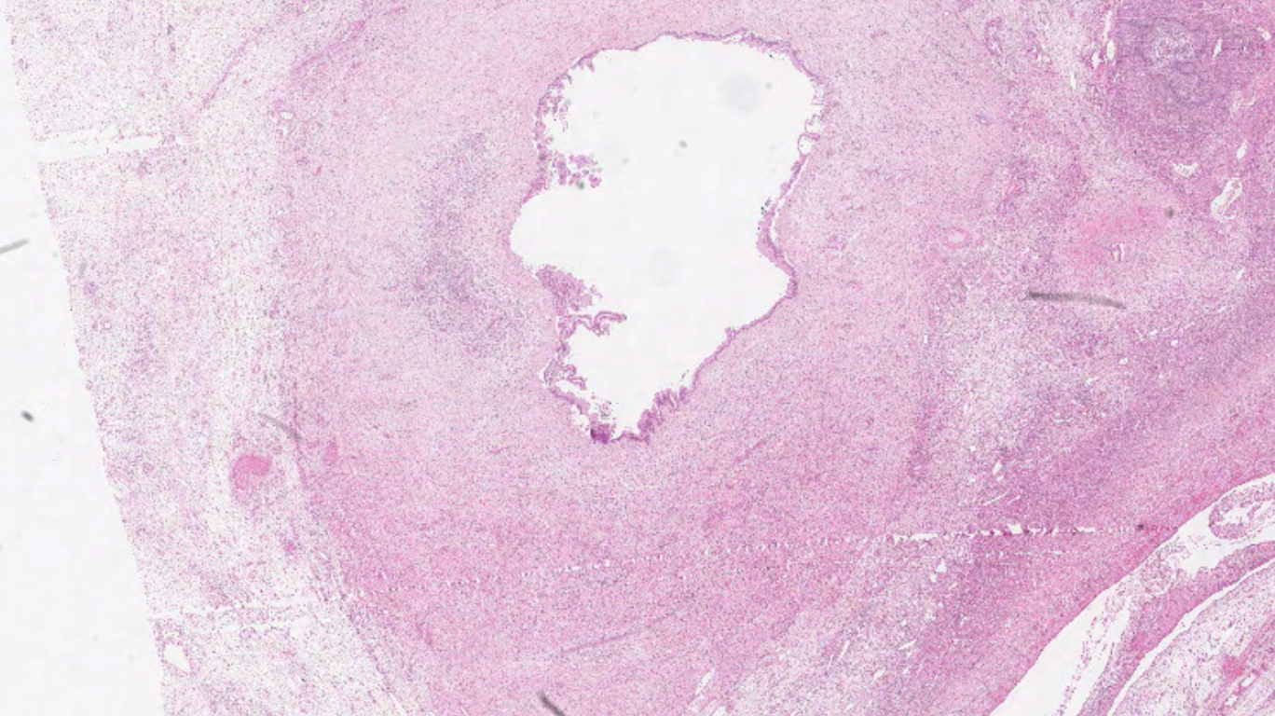

Slide 15
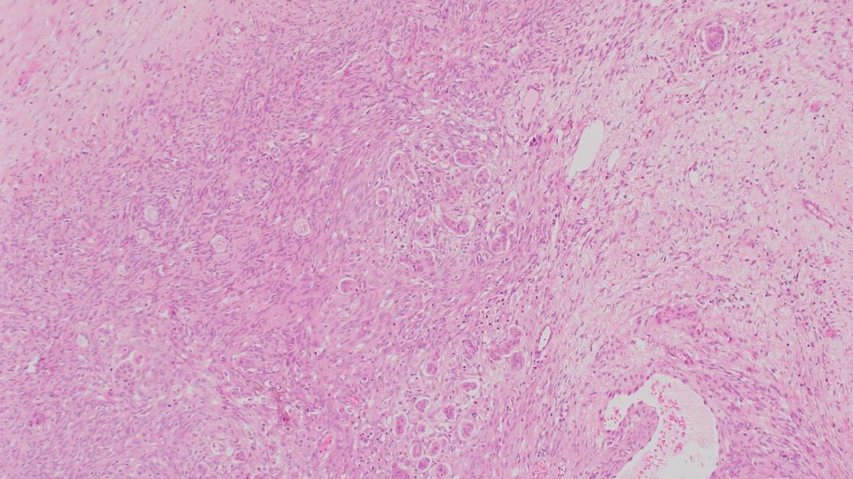

Slide 16
Case 4 Poll questions
Borderline mucinous tumour
Borderline mucinous tumour with microinvasion
Primary ovarian mucinous carcinoma - infiltrative pattern
Metastatic mucinous carcinoma

Slide 17
Case 5
56 year old woman
Right ovarian mass
At laparotomy, widespread disease
Macroscopically, ovarian cyst 8 cm partly ruptured. Spongy multicystic appearance with one solid area 3.5 cm. Omentum, peritoneal biopsy, umbilical nodule – all firm with fat interspersed by fibrous streaks.

Slide 18
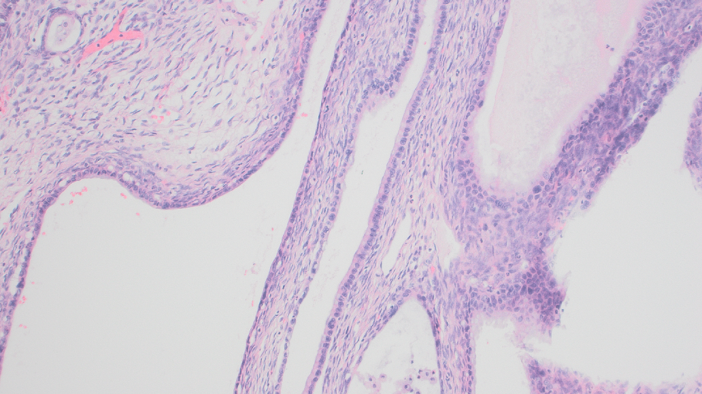

Slide 19
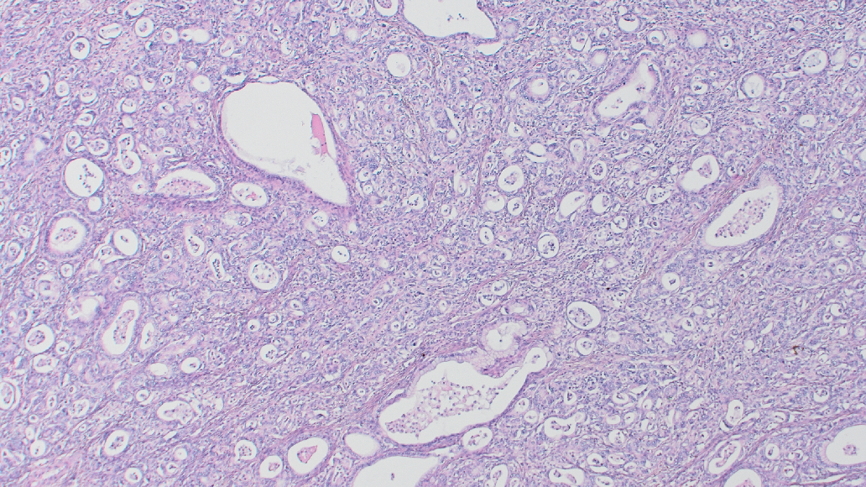

Slide 20
Case 5 Poll questions
Borderline mucinous tumour
Borderline mucinous tumour with microinvasion
Primary ovarian mucinous carcinoma - infiltrative pattern
Metastatic mucinous carcinoma

Slide 21
Case 6
52-year old female​
Unilateral right ovarian mass (sent for frozen section)​
Markedly enlarged ovary measuring 25 cm maximum dimension. Capsule largely intact, but there are areas of capsular perforation, Cut surface shows large areas of necrosis, the periphery is viable where it appears spongy and glistening​

Slide 22
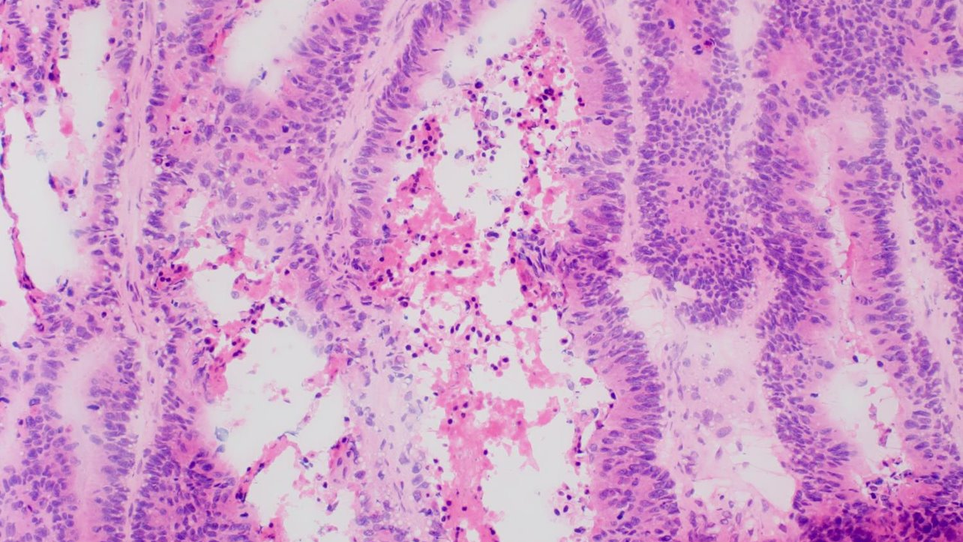

Slide 23
Case 6 Poll questions
Borderline mucinous tumour
Primary ovarian mucinous carcinoma
Ovarian endometrioid carcinoma
Metastatic carcinoma

